Slide 1



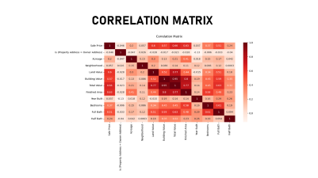
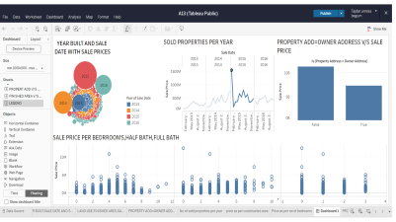
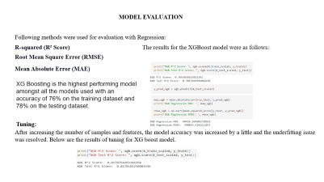

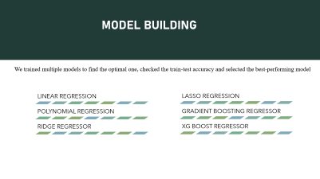

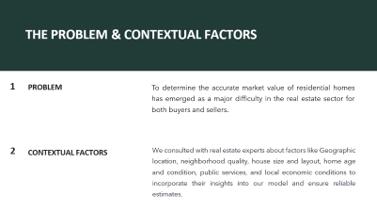
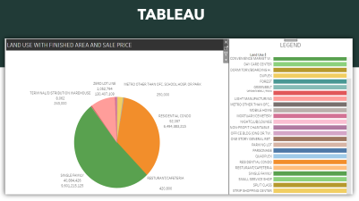
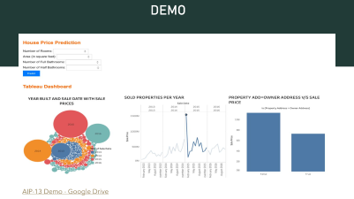
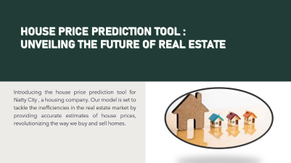
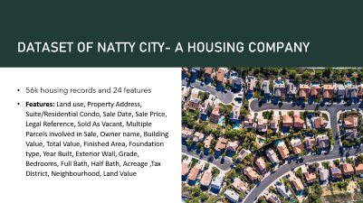
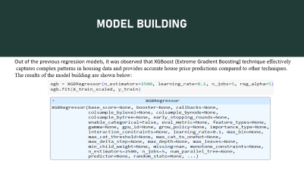
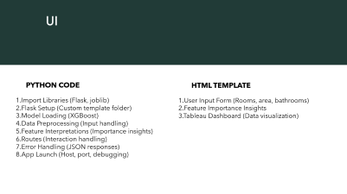
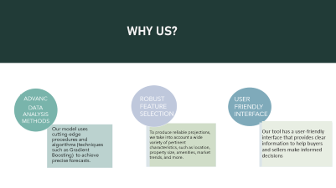
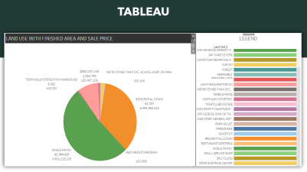
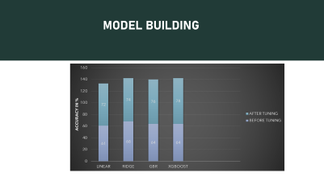
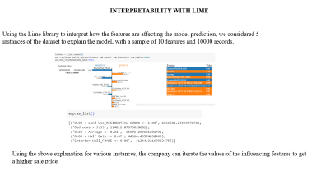
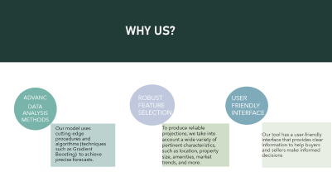

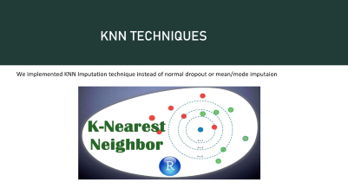
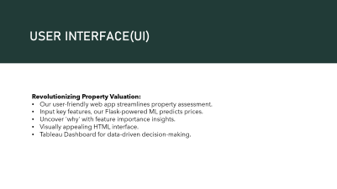


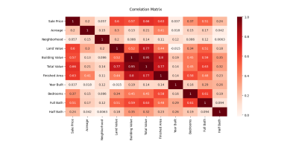

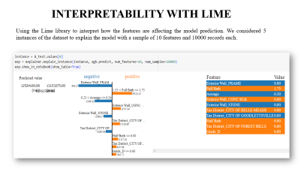




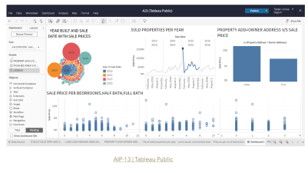
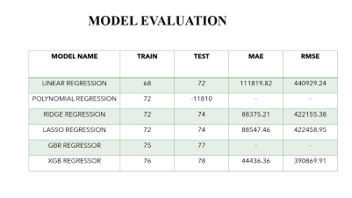
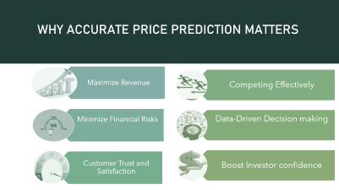
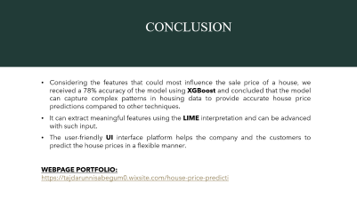
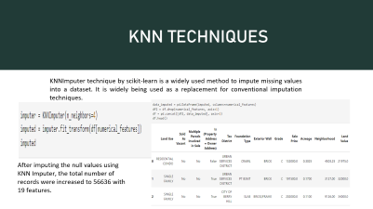

Slide 2

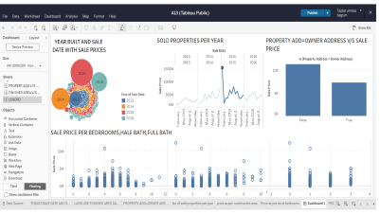


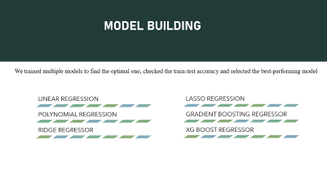

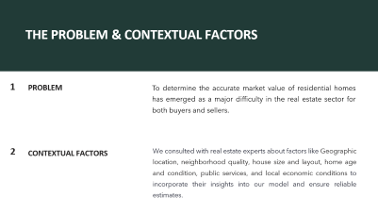





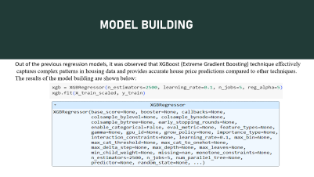





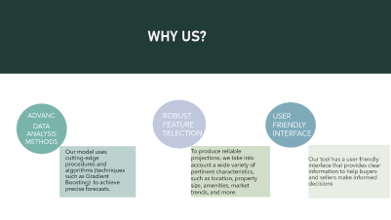


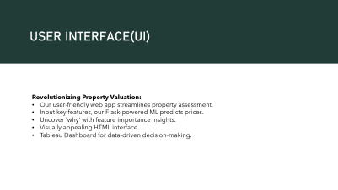

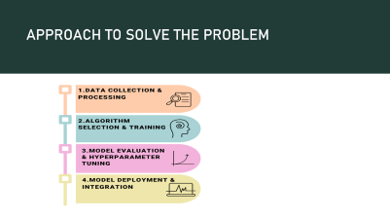

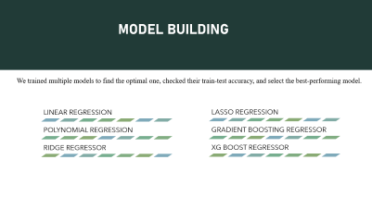






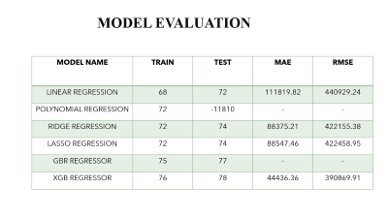
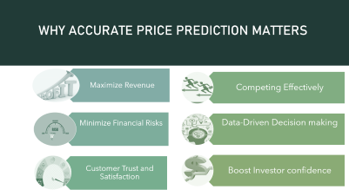
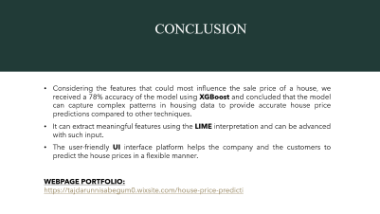

Slide 3


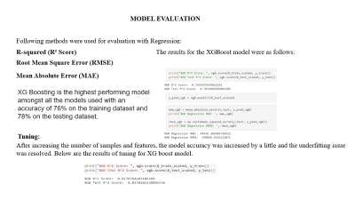





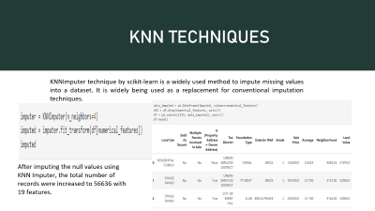












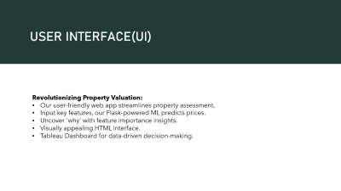

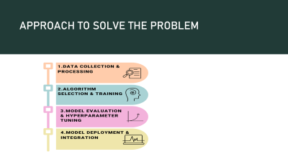







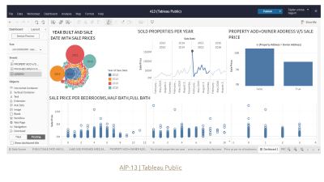




Slide 4


Slide 6
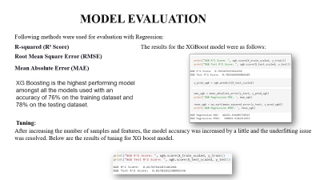



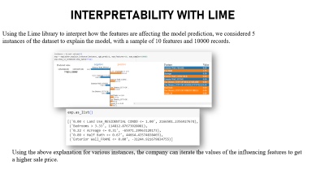
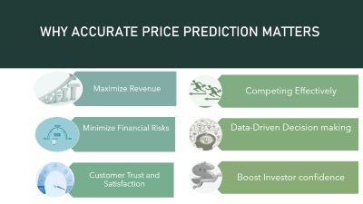

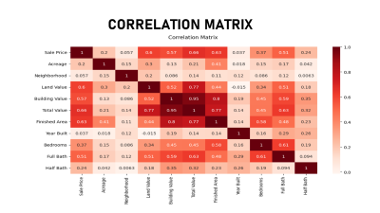

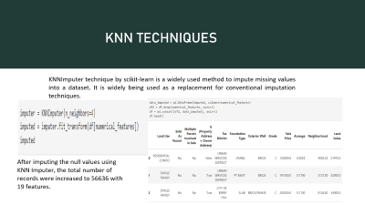

Slide 23



HUSANPREET KAUR
_________________
Documentation,Research& QA
TAJDAR UNISSA BEGUM
___________________
Project Manager,Development
NANDA KISHORE KARICHELA
_________________
Solution and designer

Slide 24

HOUSE PRICE PREDICTION TOOL : UNVEILING THE FUTURE OF REAL ESTATE
Introducing the house price prediction tool for Natty City , a housing company. Our model is set to tackle the inefficiencies in the real estate market by providing accurate estimates of house prices, revolutionizing the way we buy and sell homes.

Slide 25
THE PROBLEM & CONTEXTUAL FACTORS
1
PROBLEM
To determine the accurate market value of residential homes has emerged as a major difficulty in the real estate sector for both buyers and sellers.
2
CONTEXTUAL FACTORS
We consulted with real estate experts about factors like Geographic location, neighborhood quality, house size and layout, home age and condition, public services, and local economic conditions to incorporate their insights into our model and ensure reliable estimates.

Slide 26
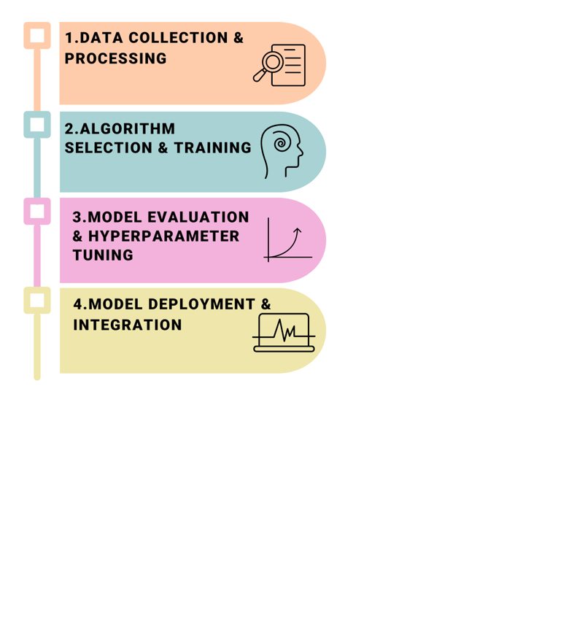
APPROACH TO SOLVE THE PROBLEM
Approaches for Solving the Problem

Slide 27

DATASET OF NATTY CITY- A HOUSING COMPANY
56k housing records and 24 features
Features: Land use, Property Address, Suite/Residential Condo, Sale Date, Sale Price, Legal Reference, Sold As Vacant, Multiple Parcels involved in Sale, Owner name, Building Value, Total Value, Finished Area, Foundation type, Year Built, Exterior Wall, Grade, Bedrooms, Full Bath, Half Bath, Acreage ,Tax District, Neighbourhood, Land Value

Slide 28
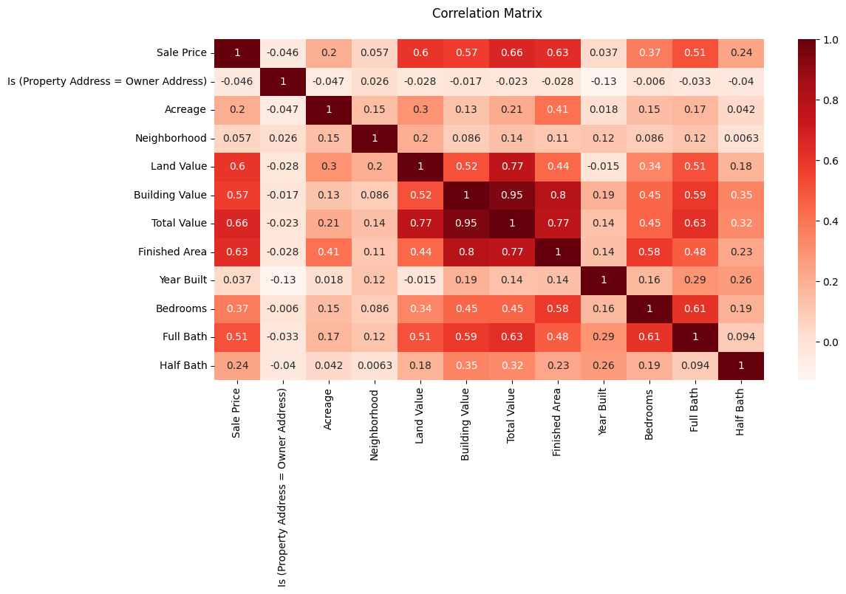
CORRELATION MATRIX

Slide 29
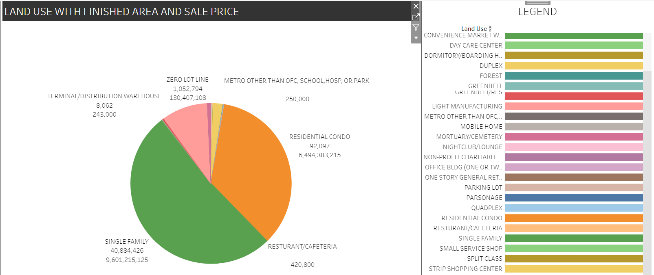
TABLEAU

Slide 30

AIP-13 | Tableau Public

Slide 31
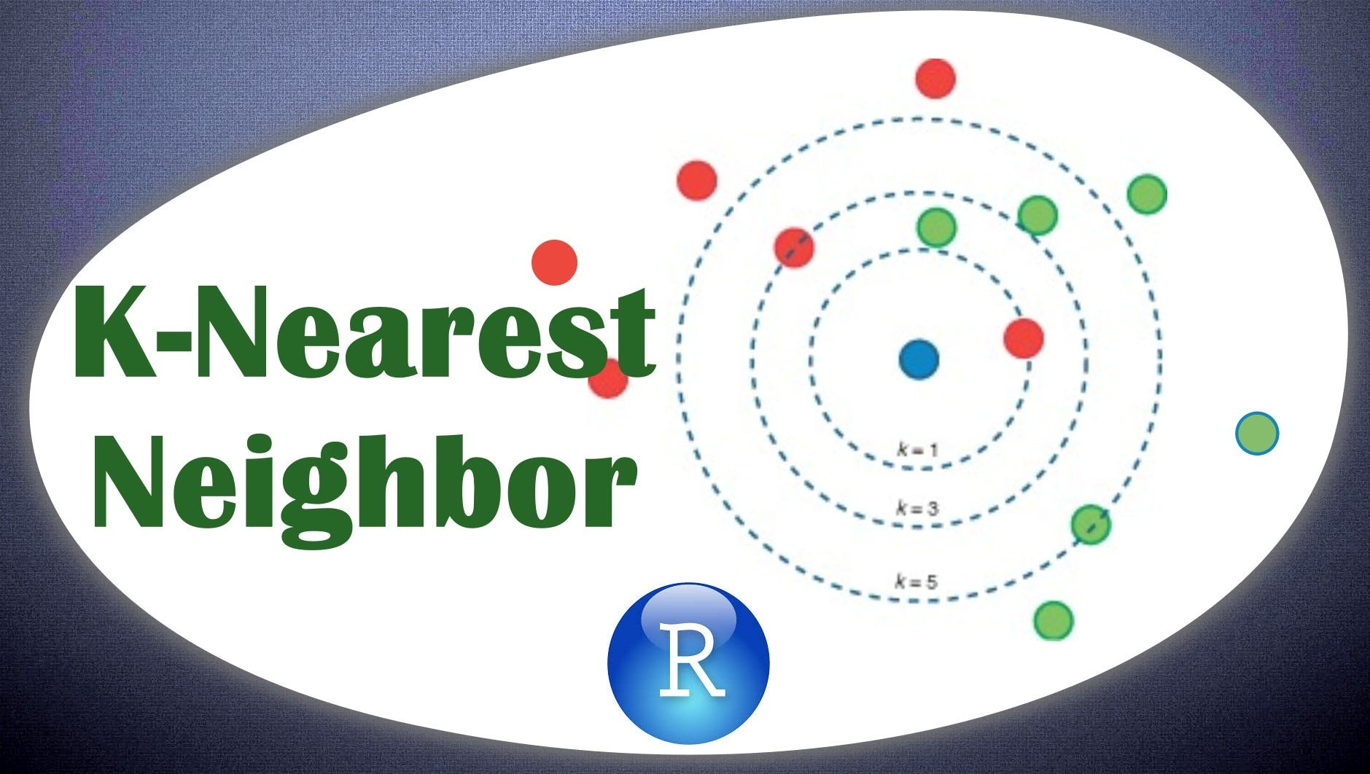
KNN TECHNIQUES
We implemented KNN Imputation technique instead of normal dropout or mean/mode imputaion

Slide 32
MODEL BUILDING
LINEAR REGRESSION
POLYNOMIAL REGRESSION
RIDGE REGRESSOR
LASSO REGRESSION
GRADIENT BOOSTING REGRESSOR
XG BOOST REGRESSOR
We trained multiple models to find the optimal one, checked the train-test accuracy and selected the best-performing model

Slide 33
MODEL BUILDING

Slide 34
MODEL EVALUATIONON
MODEL NAME | TRAIN | TEST | MAE | RMSE
LINEAR REGRESSION | 68 | 72 | 111819.82 | 440929.24
POLYNOMIAL REGRESSION | 72 | -11810 | - | -
RIDGE REGRESSION | 72 | 74 | 88375.21 | 422155.38
LASSO REGRESSION | 72 | 74 | 88547.46 | 422458.95
GBR REGRESSOR | 75 | 77 | - | -
XGB REGRESSOR | 76 | 78 | 44436.36 | 390869.91

Slide 35

INTERPRETABILITY WITH LIME
Using the Lime library to interpret how the features are affecting the model prediction. We considered 5 instances of the dataset to explain the model with a sample of 10 features and 10000 records each.

Slide 36
USER INTERFACE(UI)
Revolutionizing Property Valuation:
Our user-friendly web app streamlines property assessment.
Input key features, our Flask-powered ML predicts prices.
Uncover 'why' with feature importance insights.
Visually appealing HTML interface.
Tableau Dashboard for data-driven decision-making.

Slide 37
UI
HTML TEMPLATE
PYTHON CODE
1.User Input Form (Rooms, area, bathrooms)
2.Feature Importance Insights
3.Tableau Dashboard (Data visualization)
1.Import Libraries (Flask, joblib)
2.Flask Setup (Custom template folder)
3.Model Loading (XGBoost)
4.Data Preprocessing (Input handling)
5.Feature Interpretations (Importance insights)
6.Routes (Interaction handling)
7.Error Handling (JSON responses)
8.App Launch (Host, port, debugging)

Slide 38

DEMO
AIP-13 Demo - Google Drive

Slide 39
WHY ACCURATE PRICE PREDICTION MATTERS
Maximize Revenue
Minimize Financial Risks
Customer Trust and Satisfaction
Competing Effectively
Data-Driven Decision making
Boost Investor confidence

Slide 40

TRELLO BOARD

Slide 41
WHY US?
ADVANC
DATA ANALYSIS METHODS
ROBUST FEATURE SELECTION
USER FRIENDLY INTERFACE
Our model uses cutting-edge procedures and algorithms (techniques such as Gradient Boosting) to achieve precise forecasts.
To produce reliable projections, we take into account a wide variety of pertinent characteristics, such as location, property size, amenities, market trends, and more.
Our tool has a user-friendly interface that provides clear information to help buyers and sellers make informed decisions

Slide 42
CONCLUSION
Considering the features that could most influence the sale price of a house, we received a 78% accuracy of the model using XGBoost and concluded that the model can capture complex patterns in housing data to provide accurate house price predictions compared to other techniques.
It can extract meaningful features using the LIME interpretation and can be advanced with such input.
The user-friendly UI interface platform helps the company and the customers to predict the house prices in a flexible manner.
WEBPAGE PORTFOLIO:
https://tajdarunnisabegum0.wixsite.com/house-price-predicti

Slide 43


